Slide 1
Impact of Patents on National Growth
DATA 101 Fall 25
Project 2 - R Miranda

Slide 2
Background on the IP patent system
Patent: description of a new solution to a current or potential technical challenge. Protects the intellectual property (IP) of the inventor.
Enabled by economies that promote creativity, manufacturing and scientific infrastructure, commercialization on a global scale, and financial support for inventors and researchers, as well as regulatory protection for new ideas.
Science Infrastructure
Researchers
Publications
Patents
Trade
Export
GDP
Financial
Support
Manufacturing
capabilities
Regulations

Slide 3
Leading questions
Do countries that invest more in R&D produce more patents?
Are more patents leading to more trade (exports in particular)?
Is the growth of R&D and patents leading to growth in GDP?
Importance:
Quantifying those connections may lead to better policy of investment in R&D.
Note:
H₀= R&D investment does not affect Patents or trade or GDP.

Slide 4
Dataset used
USPTO (US Patent and Trademark Office): patent tables.
World Bank indicators: GDP, Exports, R&D funding, Manufacture, Researchers.
Our World in Data: Trade, Country by income level, Publications.
The bound dataset, once cleaned, covers well the 2000-2020 period for roughly 170 countries and contains about 1.1M records.

Slide 5
Selected variables
.Year_application
.Year_grant
.WIPO_field
.WIPO_sector
.Men
.Women
.Country
.Income_class:
(Low,
Lower-Medium,
Upper-Medium,
High)
.RD_spending
.Researchers/mill
.Publications/mill
.Manufacturing
.Exports
.Trade
.GDP

Slide 6
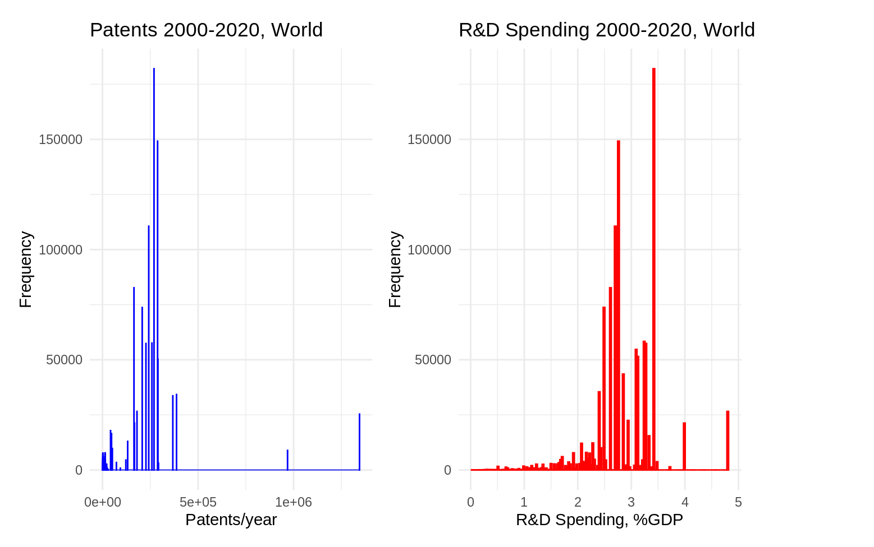
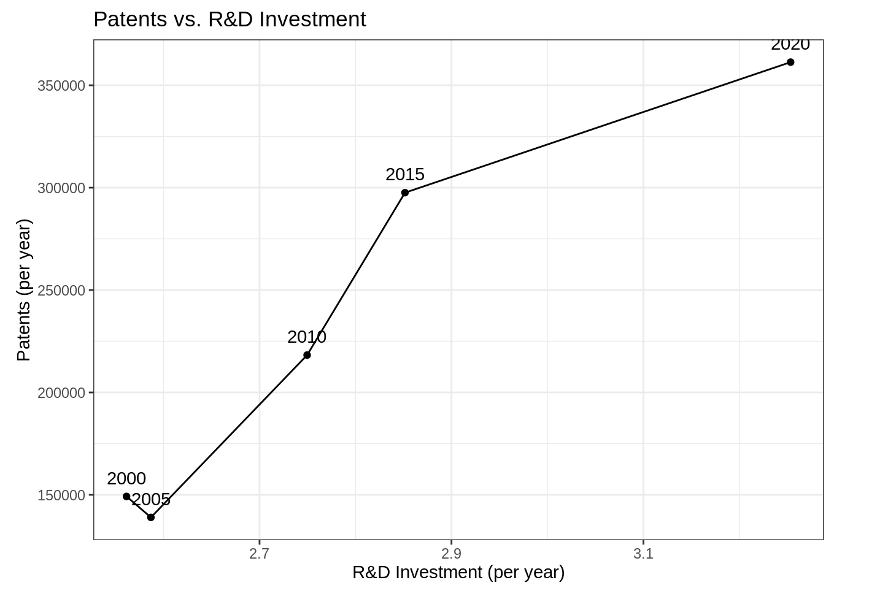
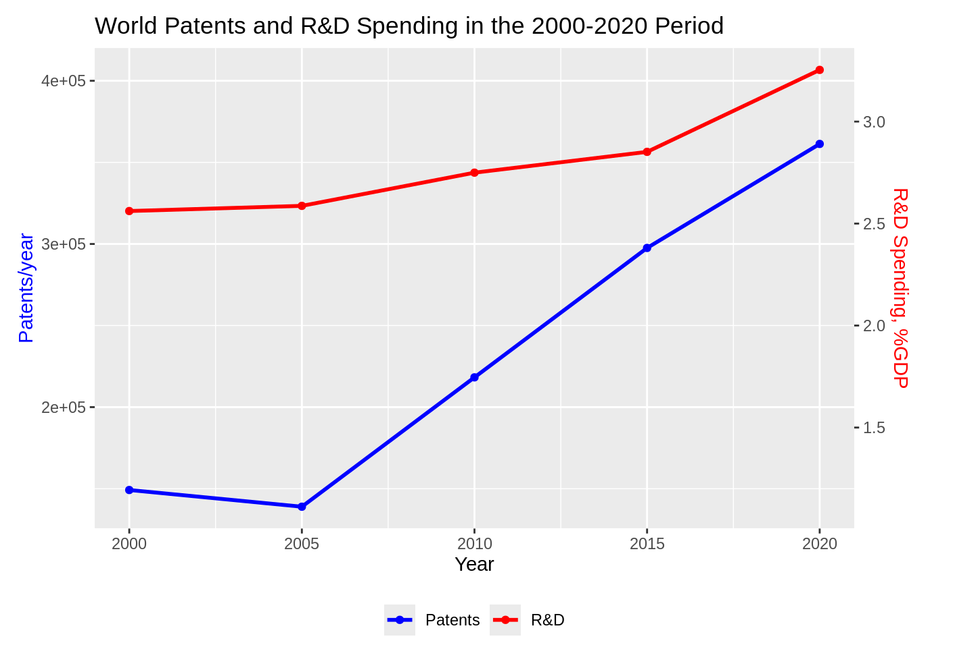
Exploratory data analysis

Slide 7
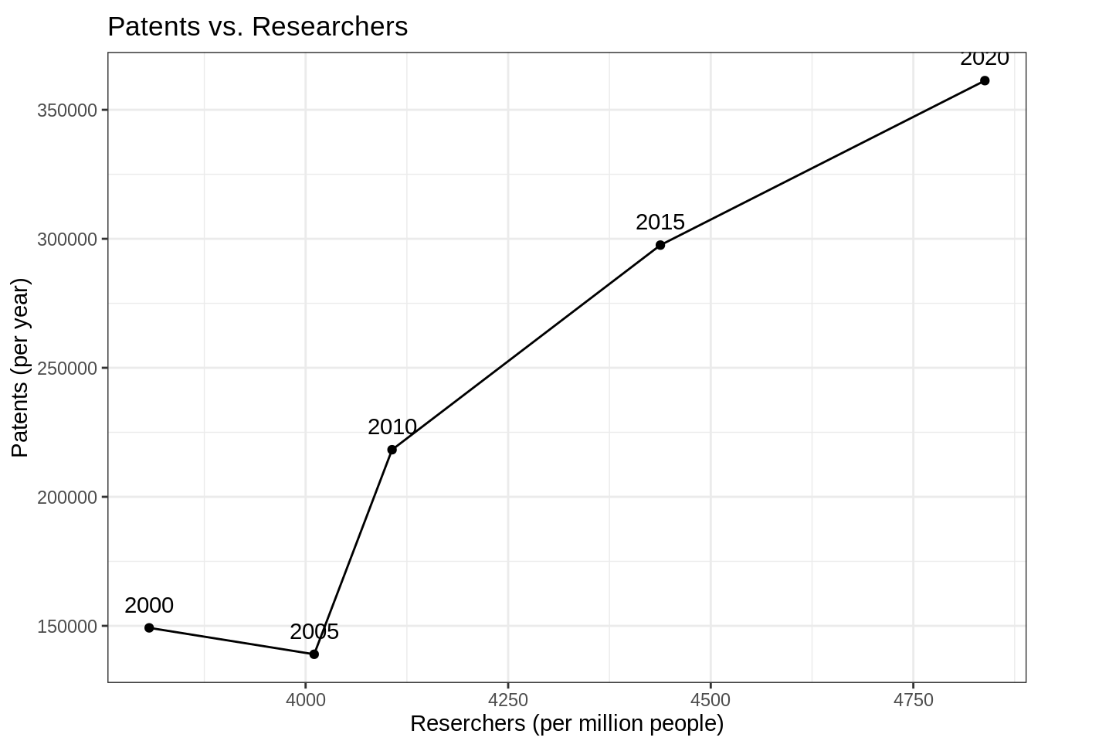
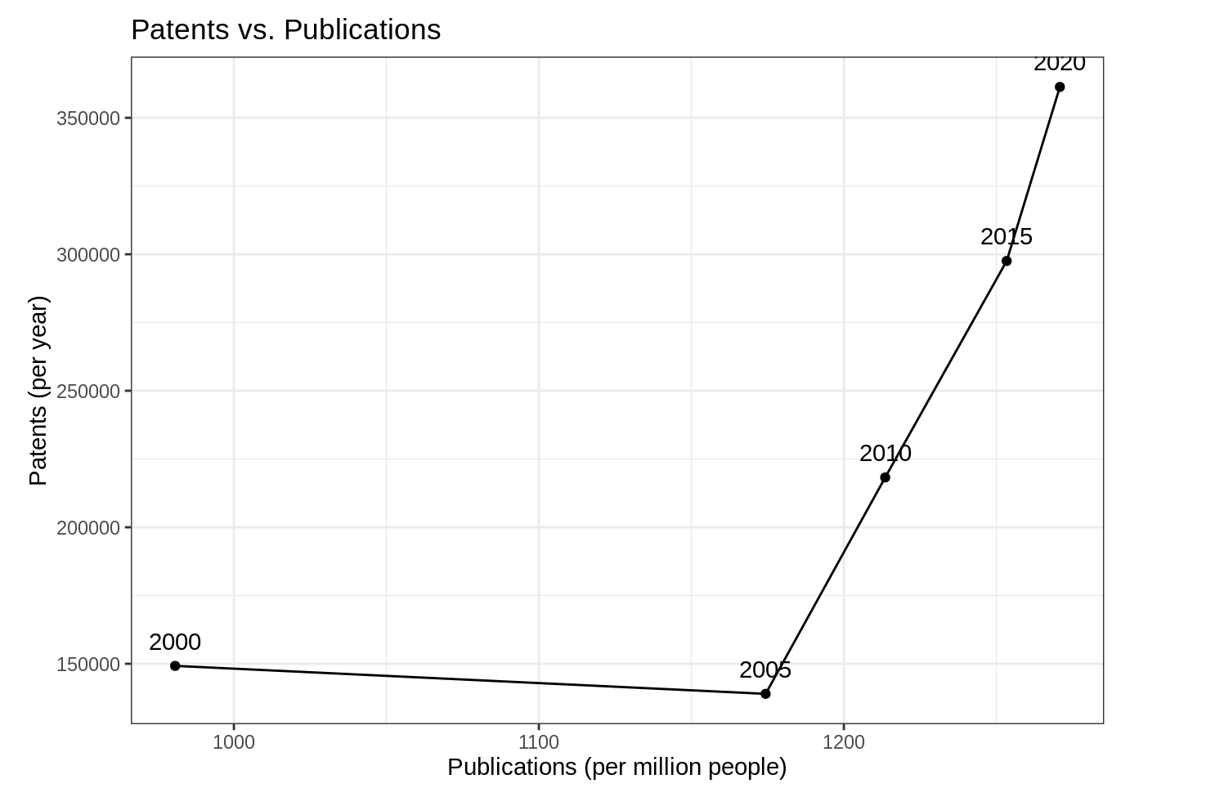
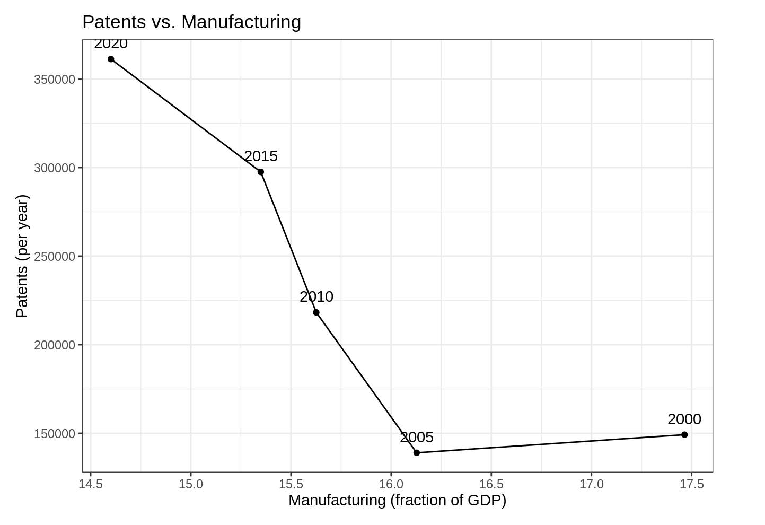

Slide 8
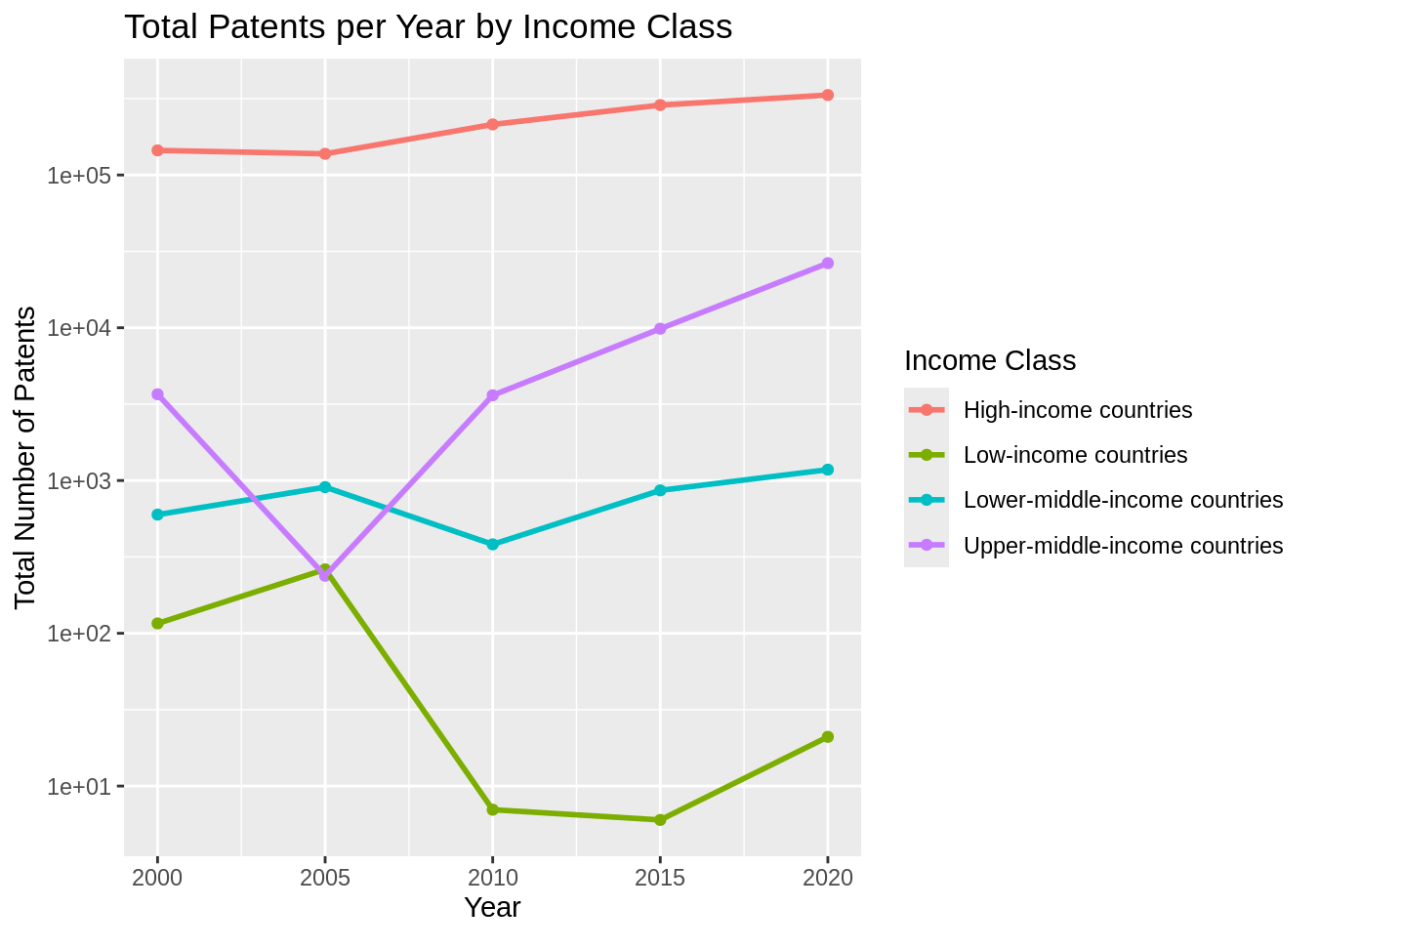
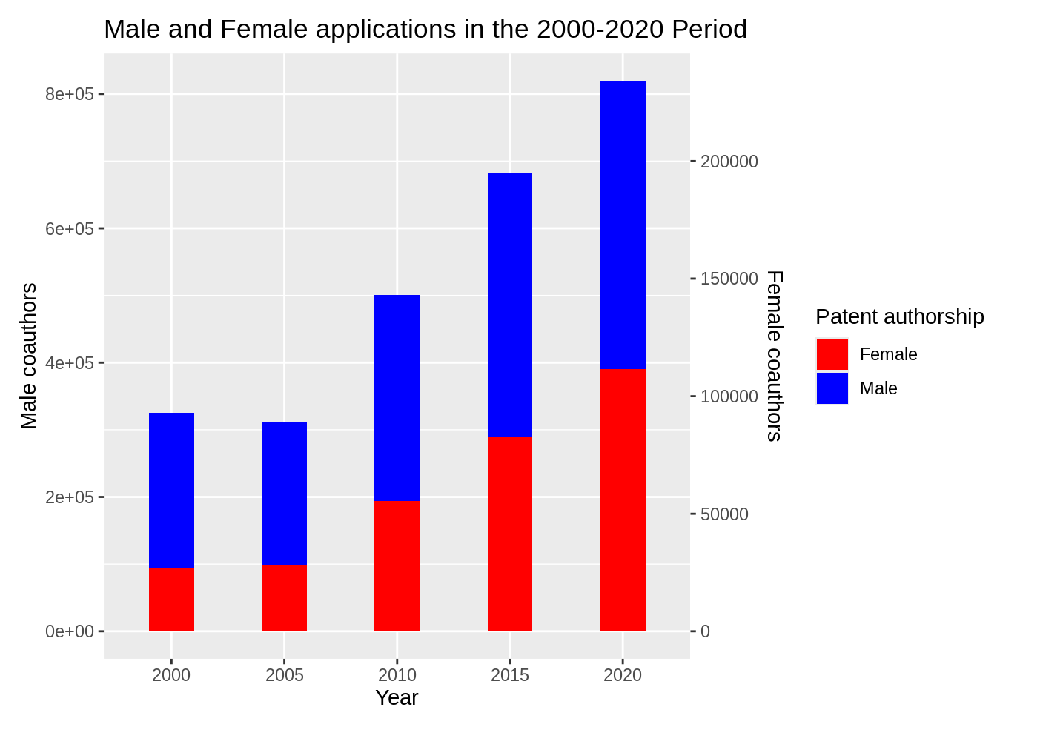

Slide 9
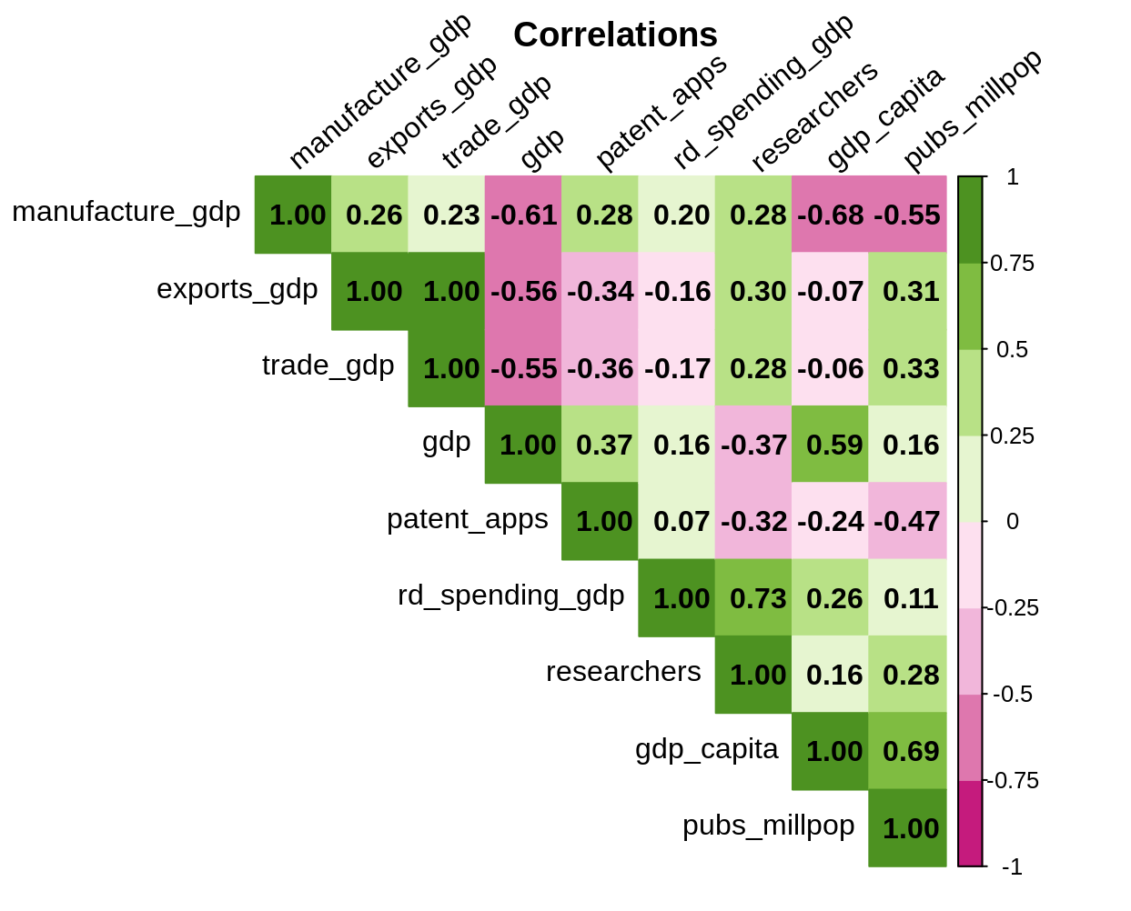

Slide 10
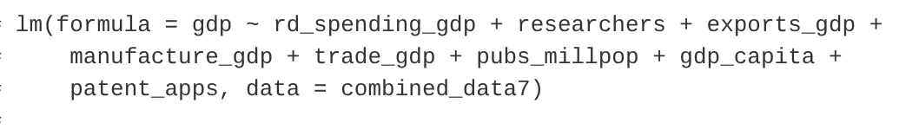
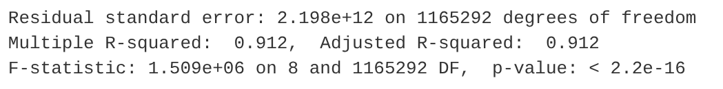
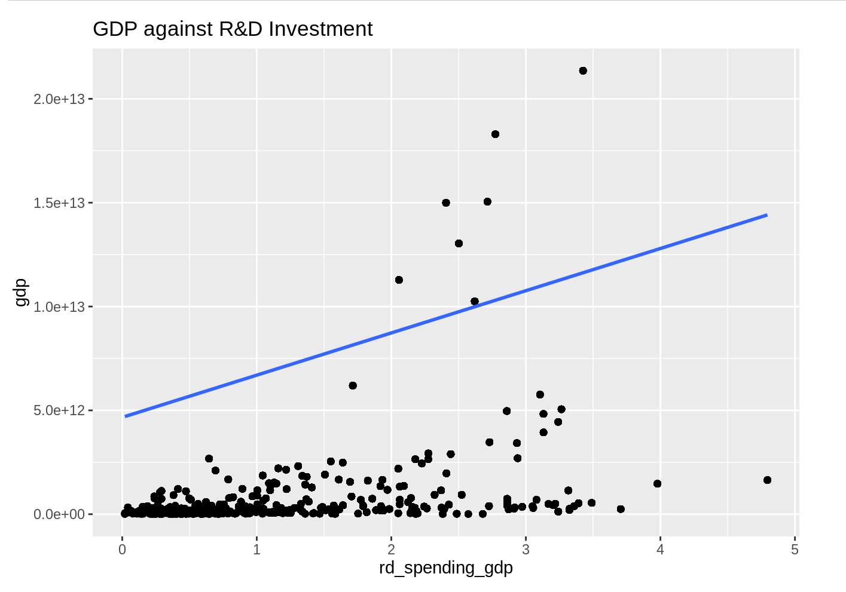
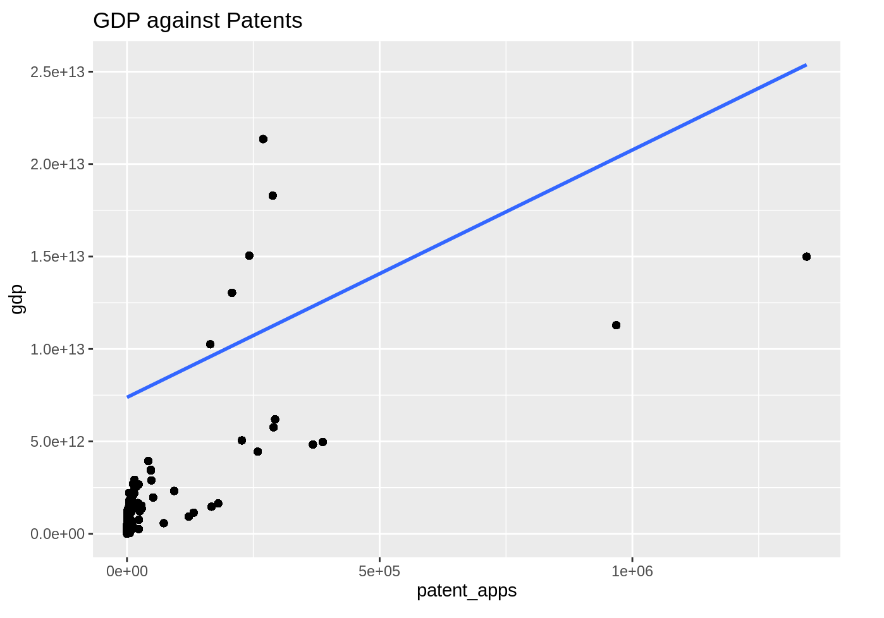

Slide 11
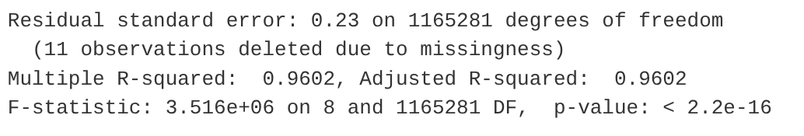
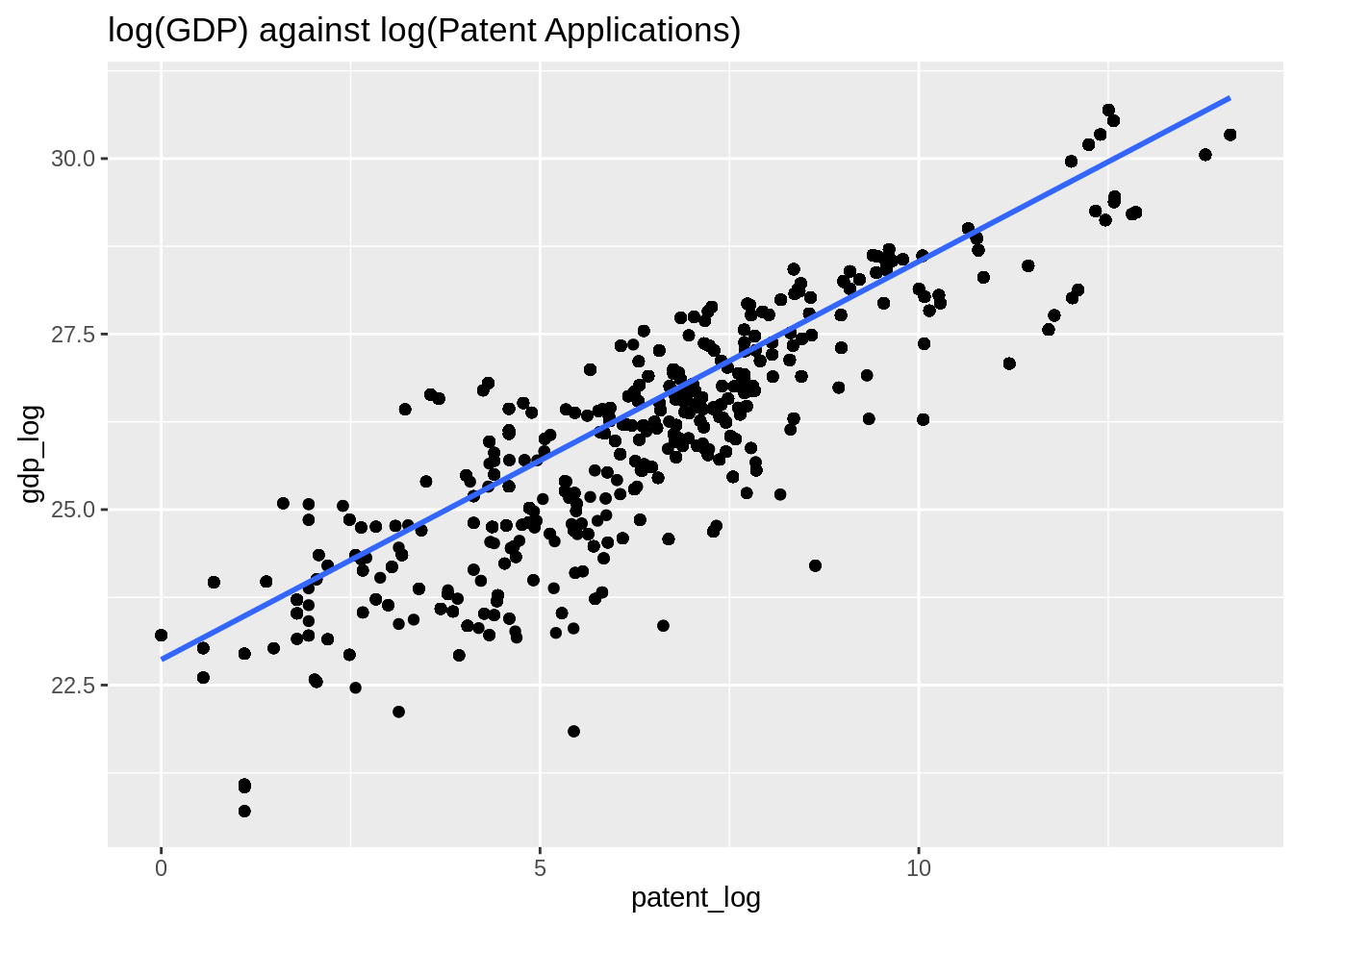
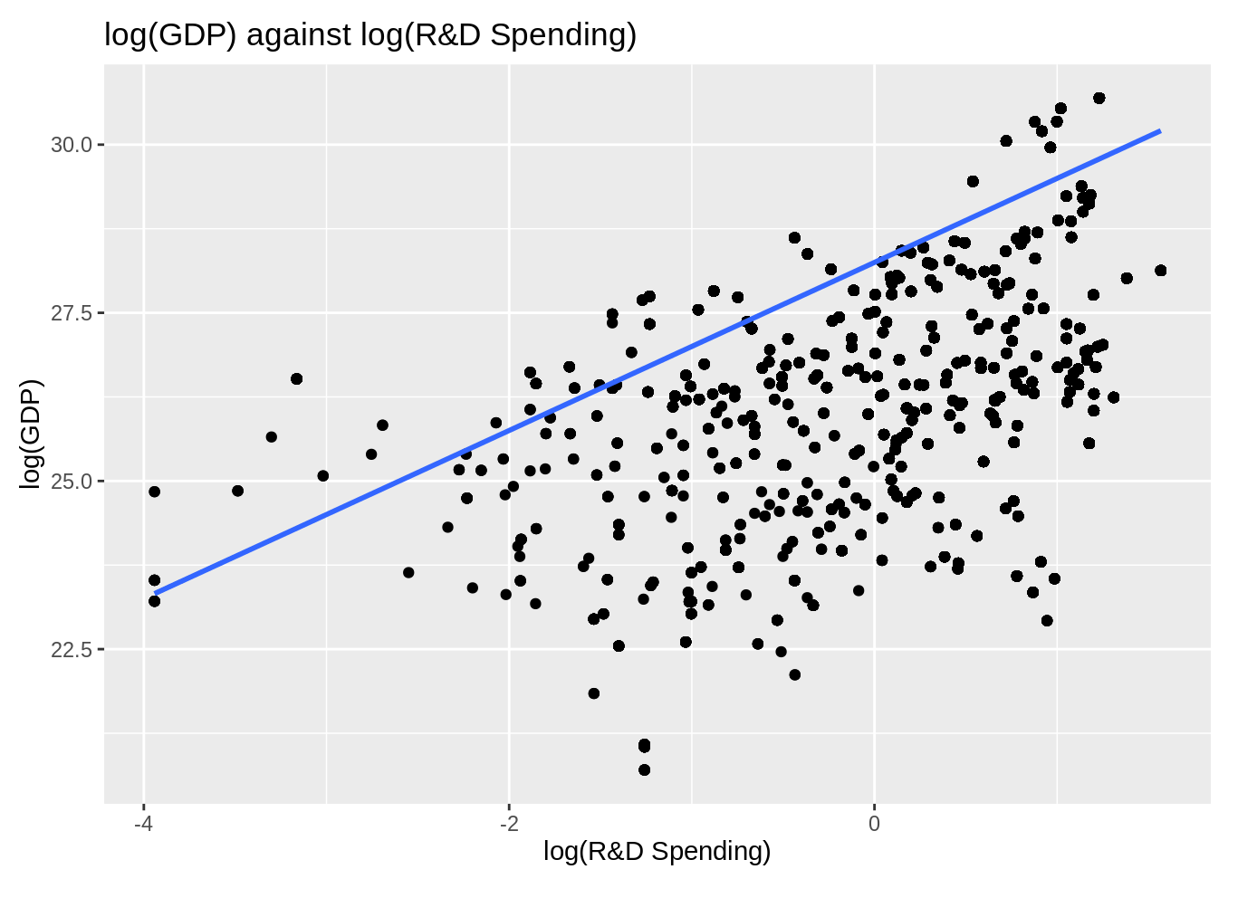

Slide 12
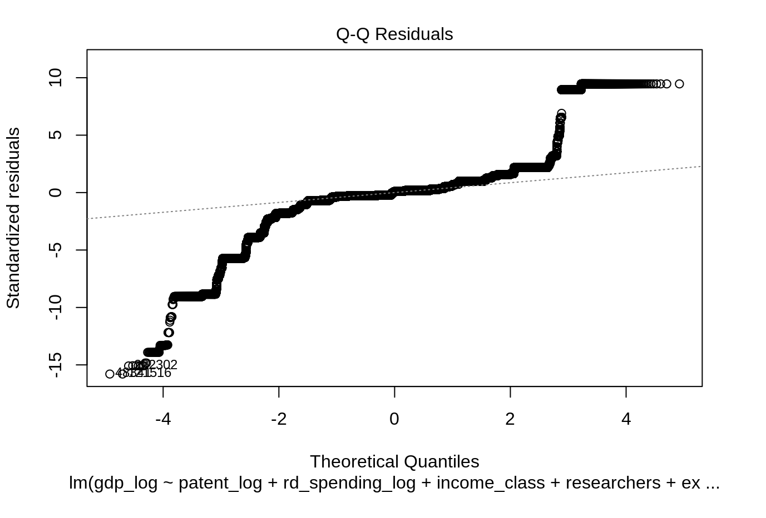
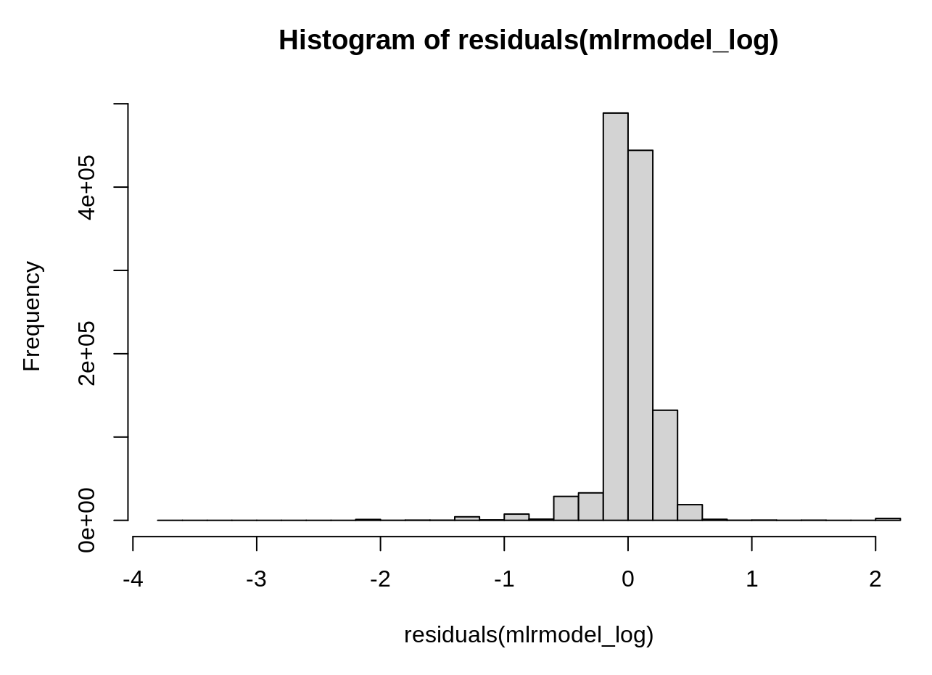
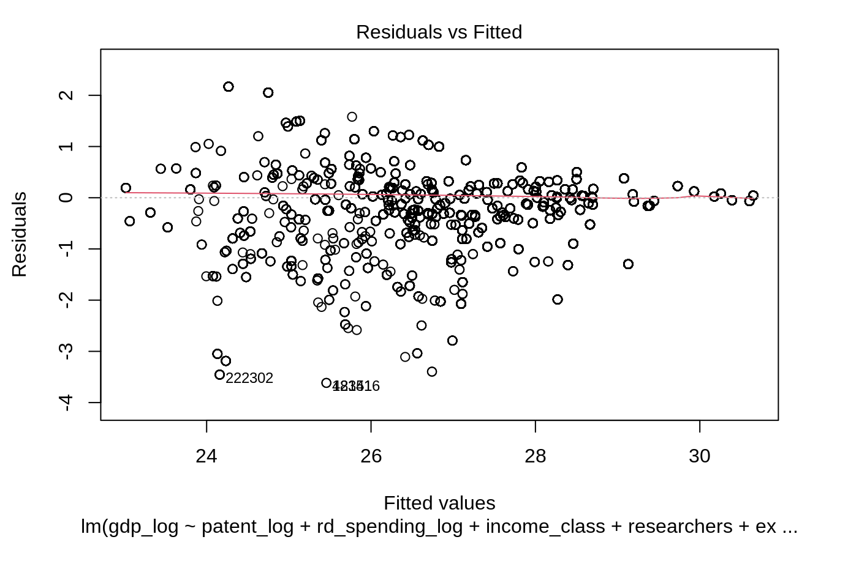
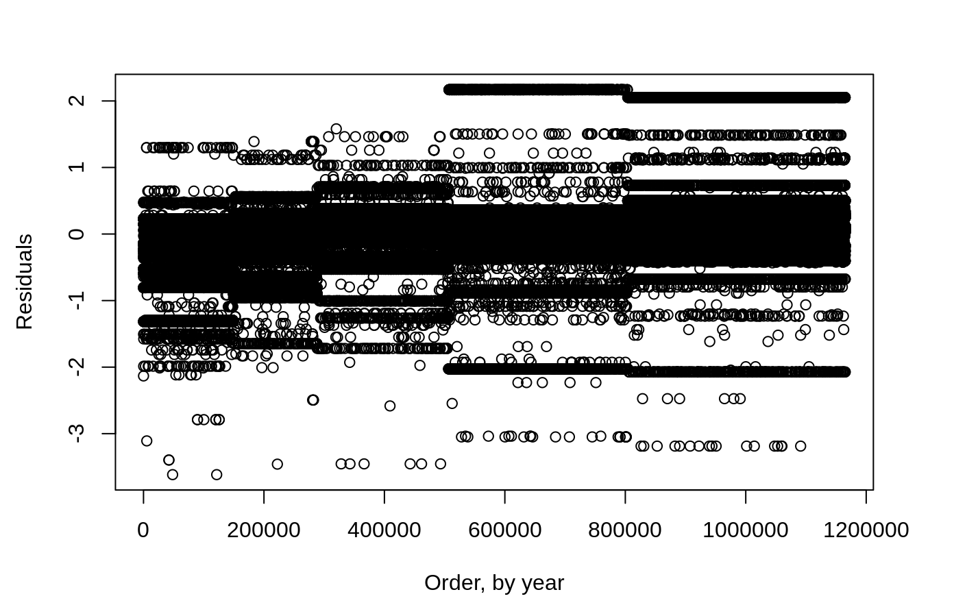
Normality and homoscedasticity

Slide 13
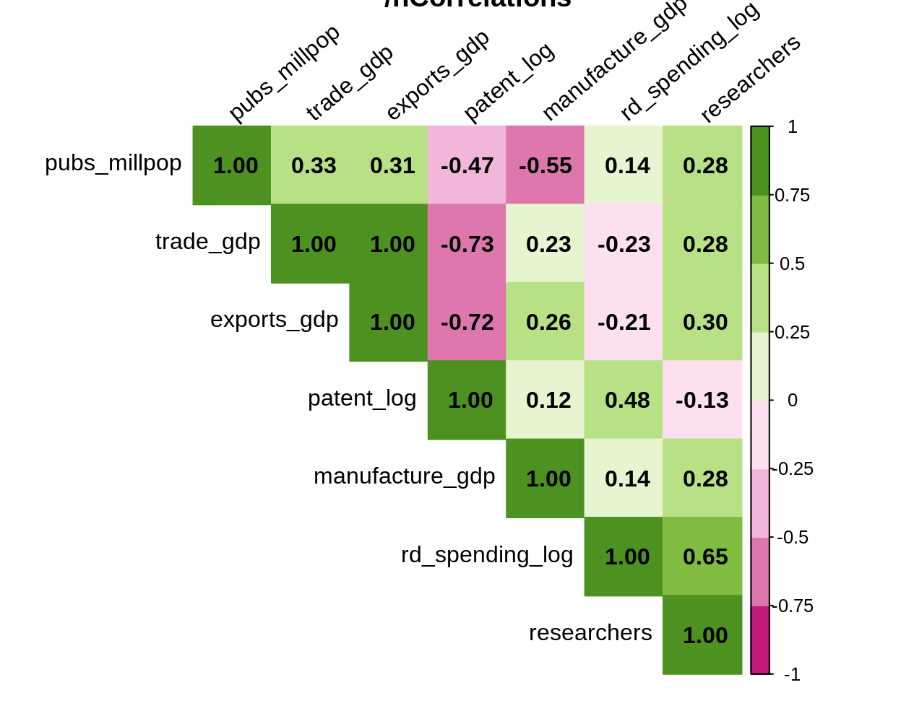
Multicollinearity of independent vars.

Slide 14
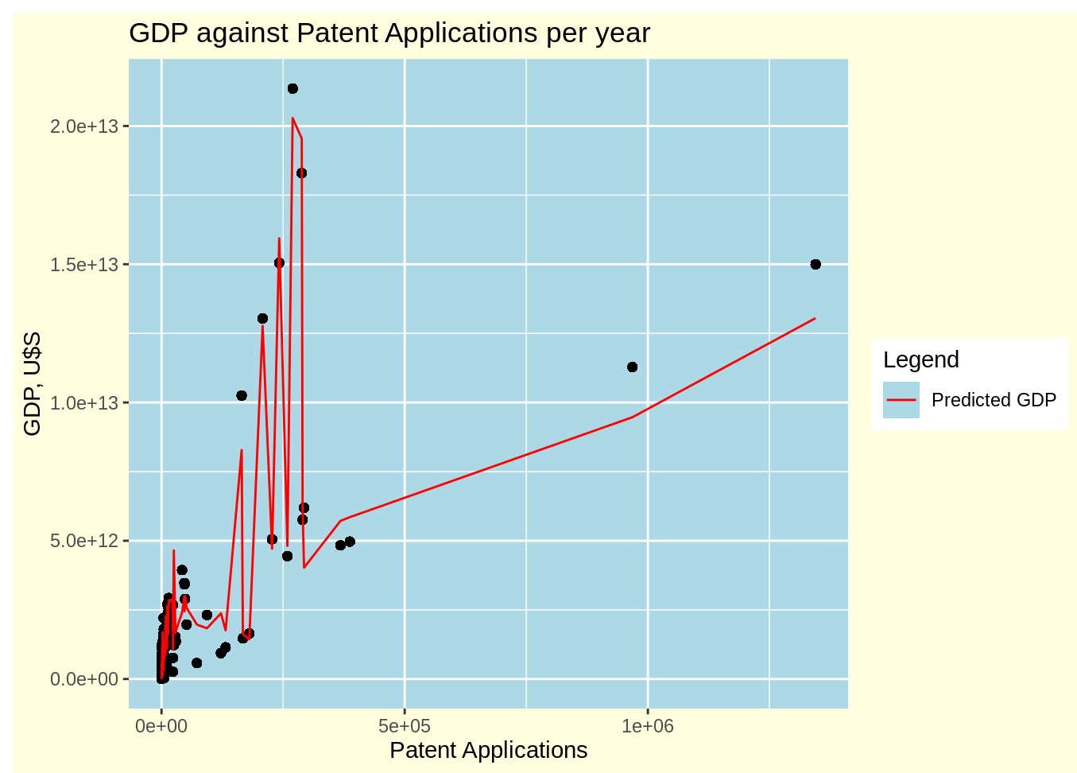
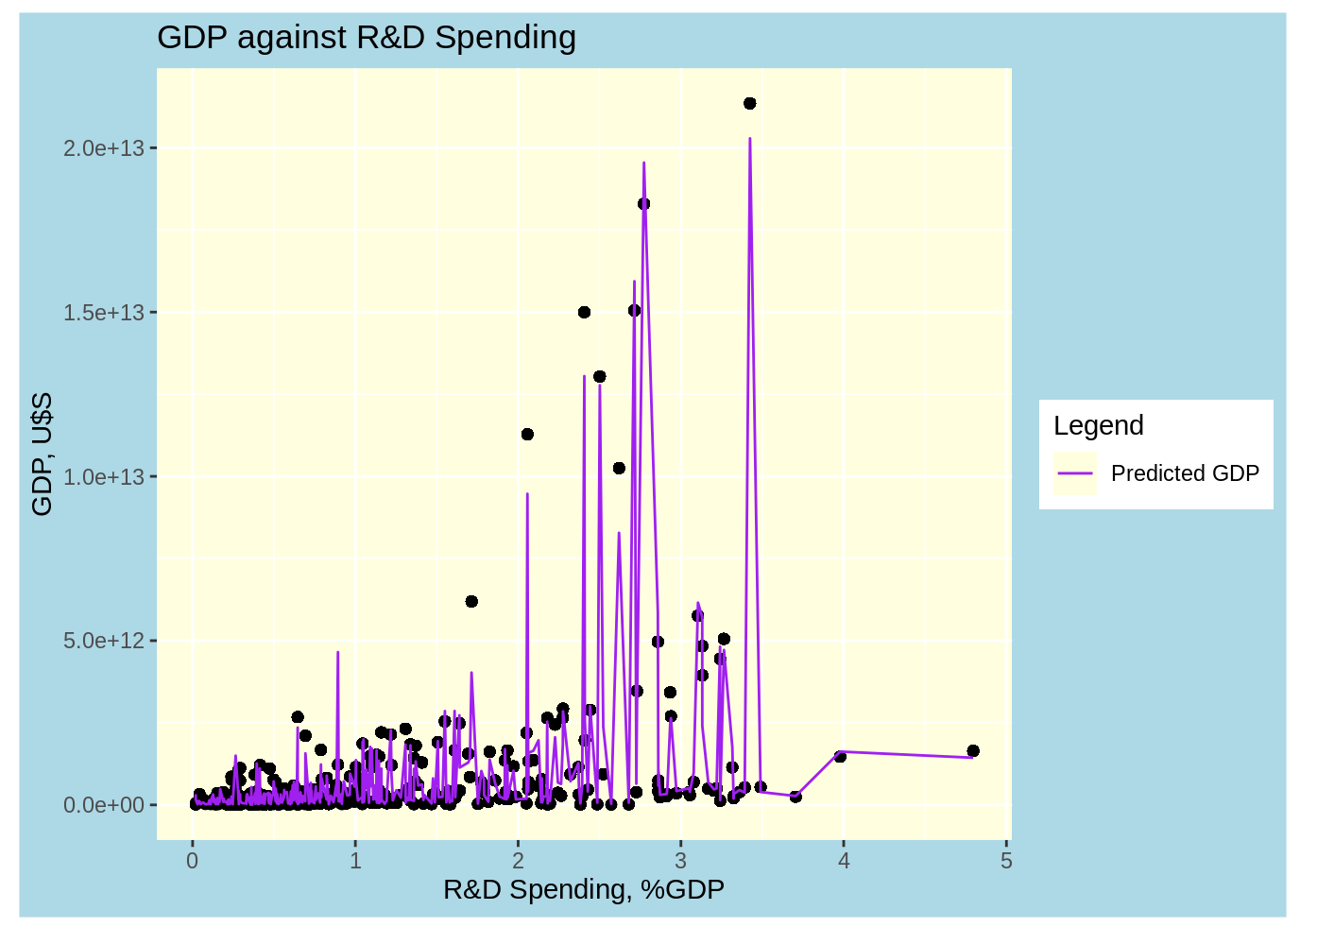

Slide 15
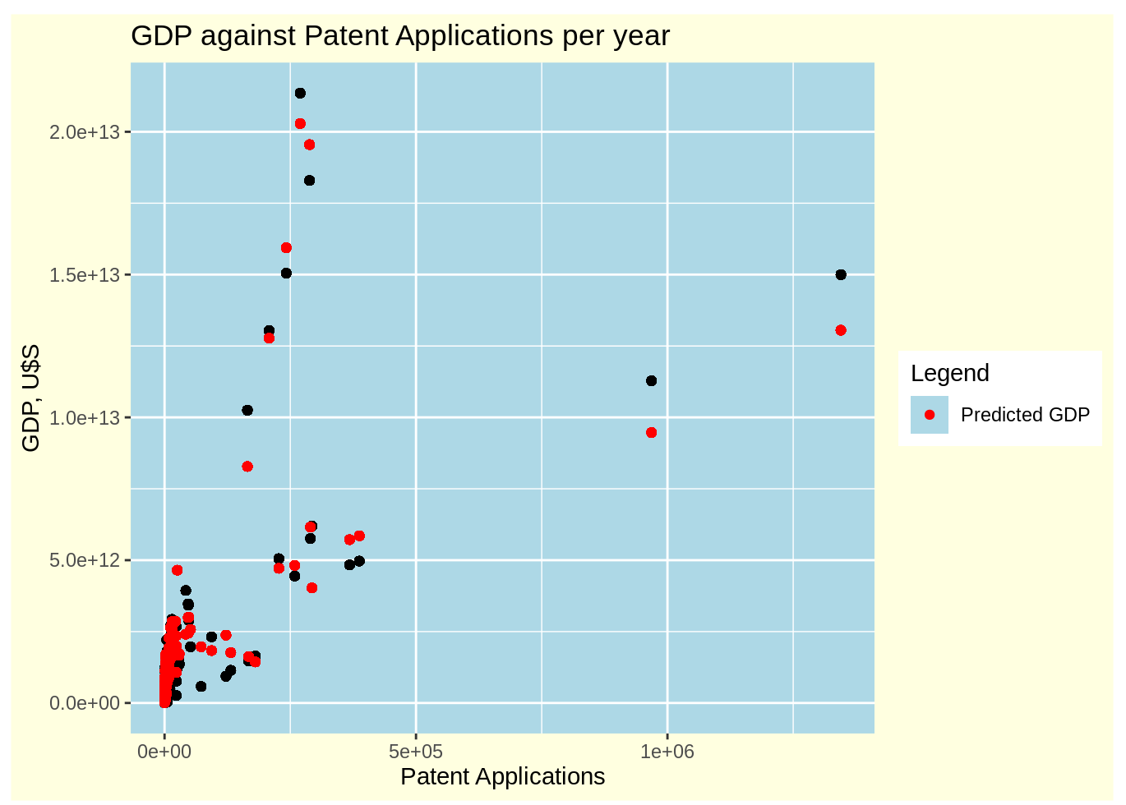
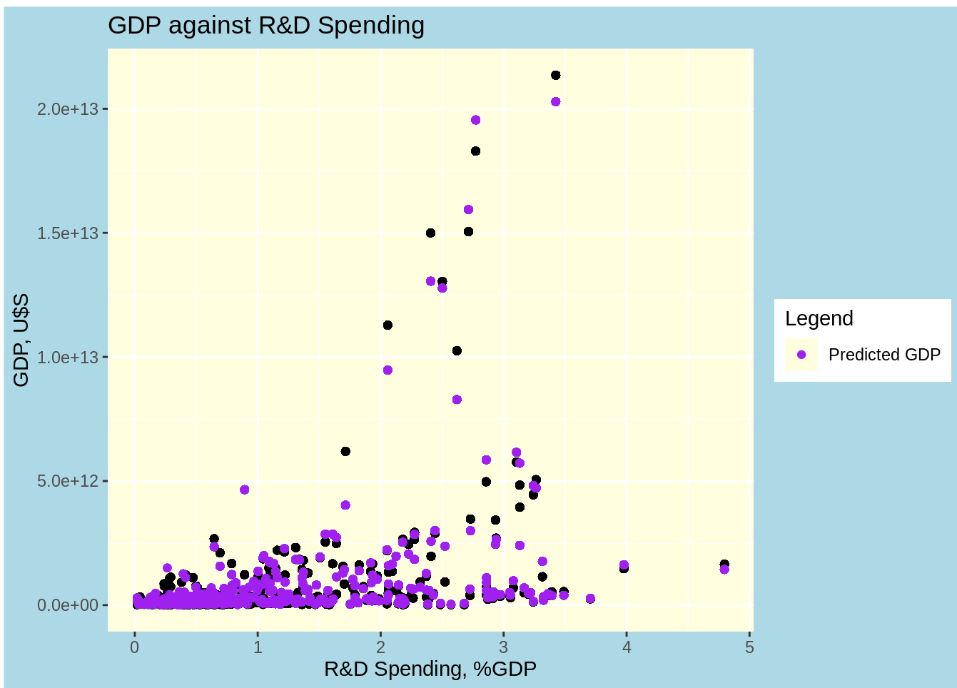

Slide 16
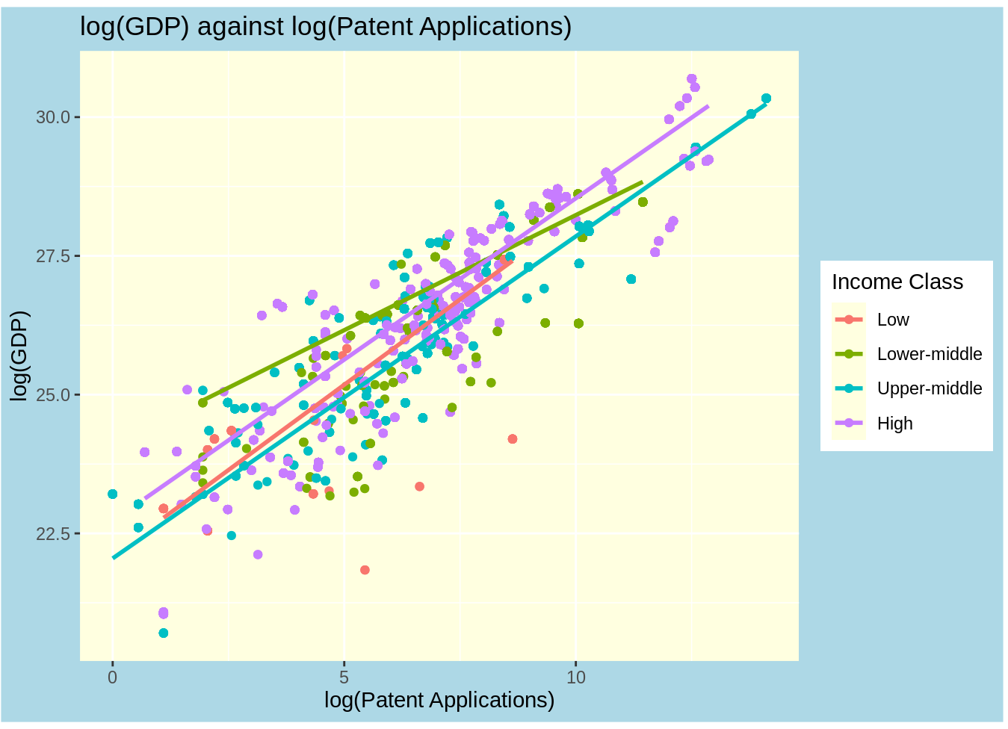
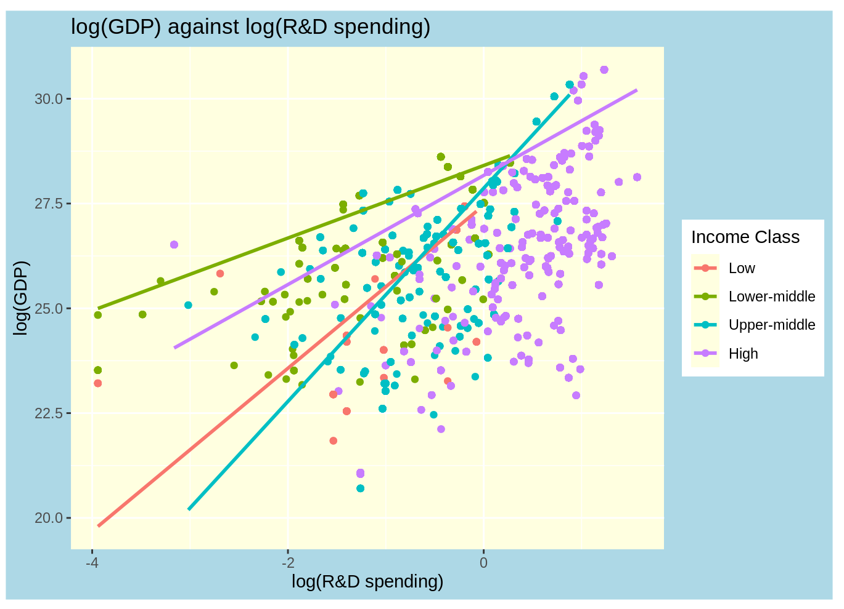

Slide 17
Conclusions
The log model is statistically more significant than the linear model and displays better goodness of fit. The log model shows normality of distribution of residuals and homoscedasticity, while the linear model shows accumulation towards the lower and higher quantiles.
The original questions were:
Do countries that invest more in R&D produce more patents?
Are more patents leading to more trade (exports in particular)?
Is the growth of R&D and patents leading to growth in GDP?
The models support the alternative hypothesis that R&D investment affects GDP. More specifically, the predicted ROI is significant. The predicted trends show that increasing patent applications, trade, and scientific publications are favorable for GDP growth.
The model predicts negative effects on GDP from increased national manufacturing, which is explainable but requires further study.
The models shows that countries with higher-middle income are leveraging their R&D investment and growing their GDP at the fastest rate compared to high, lower-middle and low income countries in the 2000-2020 period.
The exploratory data analysis showed that the female/male ratio of inventors, which reached about 25% in 2020, is increasing fast.

